Slide 2
List of contents
Project planning
Interfaces
Final remarks

Slide 3
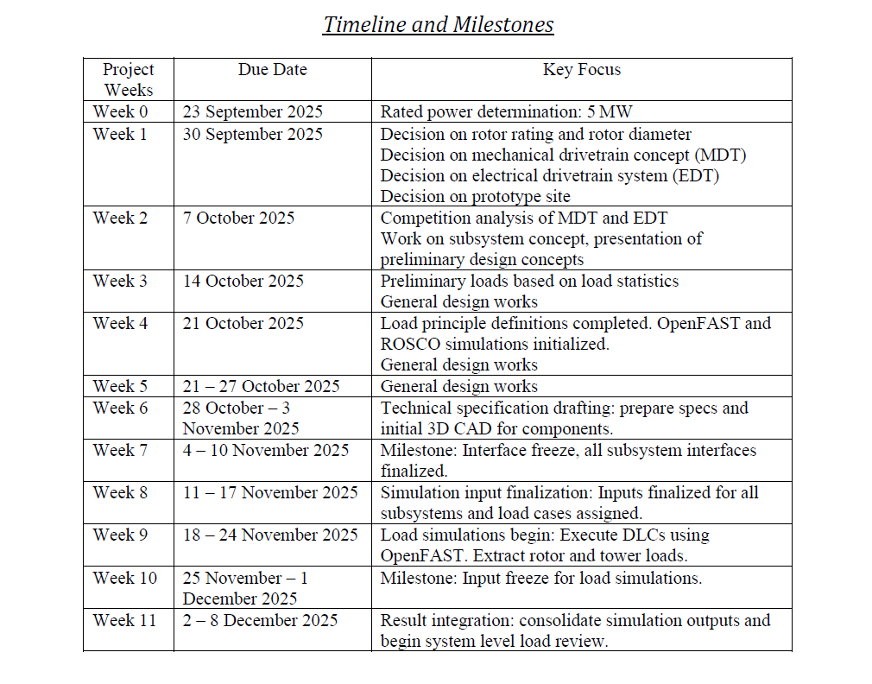
1. Project planning
Design parameters assumption/calculation
General timeline
Safety calculation for the designed parameters with Shakti loads
3 D models initialization
Dimensions approval
New loads calculated for our turbine
FINAL DESIGN APPROVAL!

Slide 4
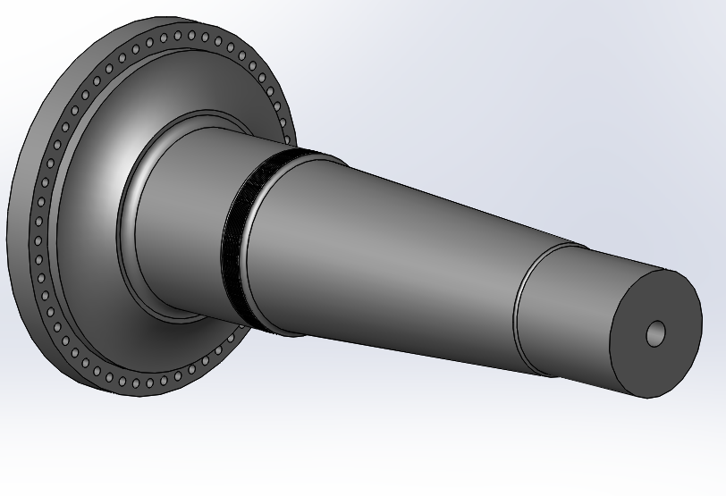
2. New interface updates
Rotor hub – Low Speed shaft flanged connection
name of the parameter | value | unit | status (fixed/not fixed) | SI remark
internal row bolt circle diameter | 1940 | mm | not fixed | based on the new value of shaft outer diameter
external row bolt circle diameter | 2140 | mm | not fixed | based on the new value of shaft outer diameter
max diameter flange | 2200 | mm | not fixed
flange thickness for shaft | 150 | mm | not fixed | same as shakti
flange thickness for hub | 150 | mm | not fixed | same as shakti
Bolt holes diameter | 42 | mm | not fixed | Because M39 are used
Bolt tighening tool max dimension | 102 | mm | fixed
flange radial thickness |  |  |  | Needs to be decided based on the dimension of the tool
Shaft from Optimus 92 LE
[1]

Slide 5
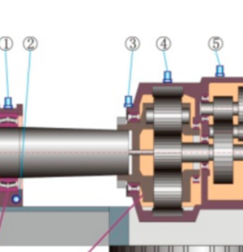
2. New interface updates
Gearbox – Low Speed shaft flanged connection
name of the parameter | value | unit | status (fixed/not fixed) | SI remark
Flange outer diameter | 1595 | mm | Fixed | Decided with professor from shaft diameter
Space for the tightening tool | 80 | mm | fixed
Flange radial thickness | 170 | mm | Not fixed
Shaft min diameter | 1255 | mm | Not fixed
Bolt circle diameter | 1435 | mm | Not fixed
Shaft – gearbox flange connection in a 3 point suspension system
Blade root – rotor hub flanged connection
name of the parameter | value | unit | status (fixed/not fixed) | SI remark
External (outer) Blade Diameter | ₃₅₂₀ | mm | not fixed | (Need to get permision from Professor)
External (inner) Blade Diameter | ₃₂₈₀ | mm | not fixed | (Need to get permision from Professor)
Bolt Circle diameter | ₃₄₀₀ | mm | fixed | Fixed by Prof. Quell & Team
Bolt Details | ₃₆ | mm | not fixed | (The Bolt Type is M36)
Root Thickness | 120 | mm | not fixed | (Need to get permision from Professor)
Hub – blade connection, Machinery components presentation
[2],[3]

Slide 6
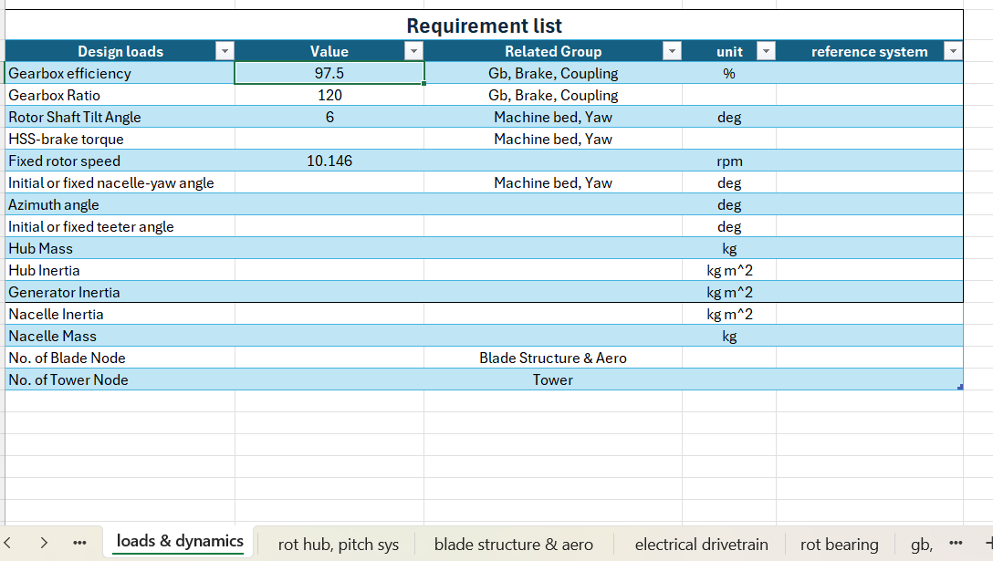
3. Final remarks
Next week the deadline must be met by all the mechanical groups: most of the components must be designed and the 3D models must have all been started
The parameters requested by the Load & Dynamics team for the simulations must be provided as soon as possible: look at ‘result file – Loads & dynamics’ and try to provide the parameters asked to your group

Slide 7
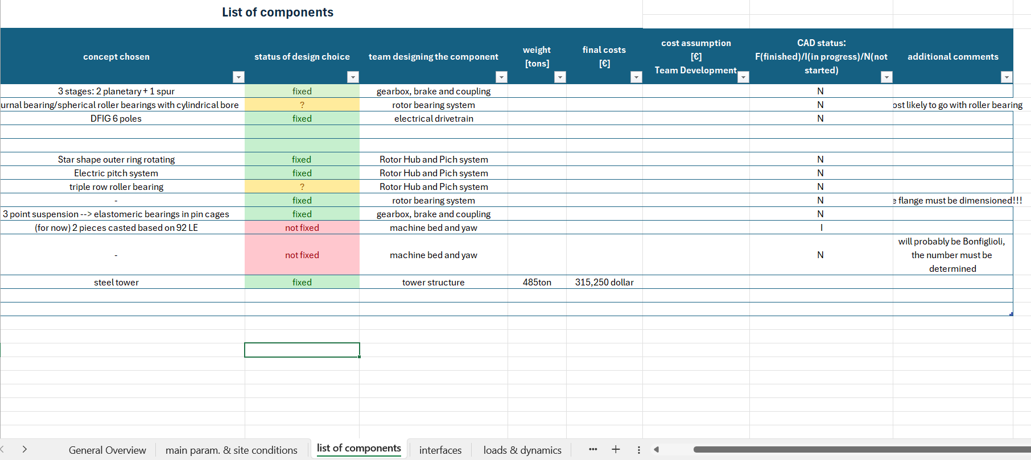
3. Final remarks
Update the status of the CAD models on the result file!!
If you have some new dimensions please upload them on the result file and possibly send them to your supervisor who can check them: WE NEED TO ALWAYS MAKE SURE THAT THE RESULTS ARE CORRECT

Slide 8
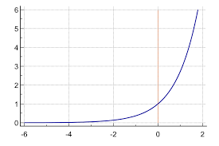
3. Final remarks
This week a great improvement in pace and quality of the work has been performed→ let’s try to continue with this regime!!!!
Progress
SUCCESS!!
Time (d)
The teams from now on!!!

Slide 9
Bibliography – Management team
[1] Optimus 92LE final presentation
[2] W. Teng, X. Ding, S. Tang, J. Xu, B. Shi, and Y. Liu, “Vibration Analysis for Fault Detection of Wind Turbine Drivetrains—A Comprehensive Investigation,” Sensors 2021, Vol. 21, Page 1686, vol. 21, no. 5, p. 1686, Mar. 2021, doi: 10.3390/S21051686. – last access: 02/11/2025 – 20:30
[3] P. Quell, “Machinery components lecture – Rotor hubs and flanges”, 2025

